Slide 1
Security and Privacy
Fall 2019
Instructor: Dr. Saeed Samet
School of Computer Science
University of Windsor

Slide 2
Chapter 0
Course Information

Slide 3
Why Security/Privacy?

Slide 4
Background
Using of computer is not restricted anymore
Networking and communication among computer systems are not exceptions
Many commercial transactions are web-based
Internet is using everywhere, by everyone
Data could easily converted to power and money
No one has 100% control over their information

Slide 5
Background
On the other hand
Modern life thrives on information and its flows
It cannot function without the computer-communication-based information systems
Therefore
Secure computing and data privacy are in high priority
It has moved from an issue among a generally known and disciplined user community to a world-wide scope with unknown, and untrusted users

Slide 6
What would be our task?

Slide 7
Background
Our task is to control the risk of computer security
Learn about the threats
Understand what causes these threats by studying how vulnerabilities arise
Survey the controls to block or reduce these threats
Develop computing styles that balance security and risk

Slide 8
What is this course about?
Introduction to Security in computing
Review various cryptography techniques to preserve data security and privacy
Examine system threats and vulnerabilities from the perspectives of
Programs
Operating Systems
Programming languages
Discuss
Database security
Internet security
Privacy-preserving data mining and machine learning methods

Slide 9
What is this course about? (cont.)
Main approaches used to preserve data security and privacy
Students contribution by
Class discussion participation
Review recent security and privacy news, articles, and issues in various applications such as in health, business and government
Project on a topic
Prepare and present your project by preparing written reports and oral in-class presentations

Slide 10
Course Outline
Introduction
Why Security and Privacy?
Definitions and Terminology
Security issues in computing
Review of Cryptography
Basic Encryption and Decryption
Symmetric and asymmetric cryptosystems
Digital signature
Cryptanalysis
Secret Sharing

Slide 11
Course Outline (cont.)
Privacy-Preserving Methods
Privacy-preserving data mining and machine learning
Secure Multi-party Computation (SMC)
Anonymization and Randomization
k-Anonymity
l-Diversity
t-Closeness
Attacks on different approaches
Collusion attacks
Data de-anonymization and re-identification

Slide 12
Course Outline (cont.)
Program Security
Secure Programs
Types of Flaws
Classic Errors
Viruses and Other Malicious Code
Trapdoors
Controls Against Program Threats

Slide 13
Course Outline (cont.)
Database Security and inference controls
Security Requirements
Reliability and Integrity
Sensitive Data
Inference and Controls for Statistical Inference Attacks
Multilevel Databases and Security
Designs of Multilevel Secure Databases

Slide 14
Course Outline (cont.)
Security and privacy on internet
Networks
Characteristics
Dimensions
Protocols
Types
Threats and Attacks
Vulnerabilities
Security Controls
Firewalls
Intrusion Detection Systems
Secure E-Mail

Slide 15
Course Outline (cont.)
Data security and privacy in various applications
Health
Business
Government
Recent security and privacy issues

Slide 16
Textbooks
Security in Computing
By Charles P. Pfleeger and
Shari Lawrence Pfleeger
4th or 5th edition, Prentice-Hall, 2007
ISBN: 0-13-239077-9, 0-13-408504-3
Handbook of Applied Cryptography
By Alfred J. Menezes, Paul C. Van Oorschot and Scott A. Vanstone
Fifth edition, CRC Press, 2001
ISBN: 0-8493-8523-7
Other reference books on Cryptography and Security

Slide 17
Evaluation
Assignments (20%)
Midterm Exam (30%) (TBD)
Class discussions (5%)
Project
Written Report (25%) (TBD)
Presentation (20%) (During the last 2-3 class sessions)
Bonus News Presentation (3%)

Slide 18
Project topics (not limited to)
Modern cryptography
Privacy and Security in Health
Privacy and Security in Social Networks
Privacy and Security in Cloud Computing
Privacy and Security in Big Data
Privacy and Security in Blockchain
Privacy and Security in IoT
Privacy and Security in Mobile Apps
Intrusion and Fraud detection
Legal, ethical, and societal issues related to security/privacy
Differential Privacy
Your own suggested topics (after approval)

Slide 19
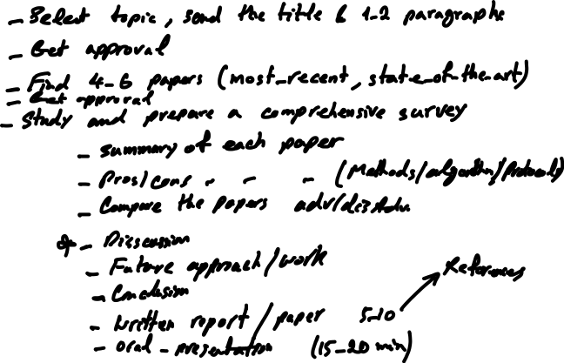
Research Project (Individual)

Slide 20
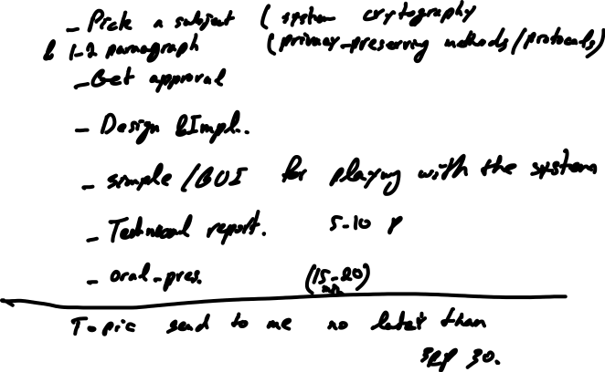
Practical Project (Individual or Team of Two Students)

Slide 21
Short News Presentation
A brief news presentation, between 5-7 minutes
Two students, as volunteers, in each class session, starting from next week class
Depending on the number of volunteers
Some sample news topics will be provided
Students can select their interested subjects, or they can present their own news topics
Every presenter will receive 3% bonus mark
The presenter should also shortly mention the lesson they get from the news
Other students will discuss on the news topic for 3-5 minutes
Presenter can provide one-page slide for the presentation
Volunteers should let me know their preferred news and date of presentation in advance
Date availability will be on first come first serve basis

